Slide 1
World Population Analysis
Created by: Jimmy Wijaya – Junior Business Data Analyst

Slide 2
Project Overview
This open-source project was created to answer open-ended questions about the World Population from different continents and different timeline.
Methodology used to answer these questions is SQL via SQLite Database.
The dataset was originally procured by our Educational Institute known as Codecademy.

Slide 3
World Population Dataset
The continents covered in the dataset are as follows:
North America
South America
Europe
Asia
Africa
Oceania
From the year 2000 to year 2010

Slide 4
Findings – Part 1
1. How many records in the table ‘countries’ are from Africa?
-- There are 56 records of the Africa continent
2. What was the total population of the continent of Oceania in 2005?
-- In the year 2005, Oceania has a total population of 33 millions approximately.
3. What was the average population in South America in 2003?
-- South America has an average population of approximately 26 millions in the year 2003.

Slide 5
Findings – Part 2
4. What countries had the smallest population in 2007?
-- In Oceania, Niue has a population of 2160
-- In South America, Falkland Islands has a population of 2970
-- In North America, Montserrat and Saint Pierre have a total population of 4510 and 6100 respectively
-- In Africa, Saint Helena has a population of 7560
These are the countries with the smallest population in 2007.

Slide 6
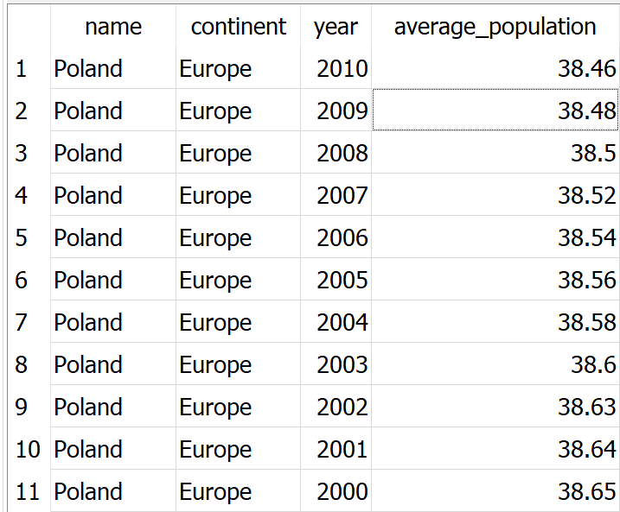
Findings – Part 3
5. What is the average population of Poland during the time period covered by this dataset?
*Please note, the number of the average population is in millions.

Slide 7
Findings – Part 4
6. How many countries in the dataset have the key word ‘The’ in their name?
-- There are four countries with the key word ‘The’ in their name.
-- In North America, there are ‘The Bahamas’ and ‘Netherlands Antilles’
-- In Europe, there is ‘Netherlands’
-- In Africa, there is ‘The Gambia’

Slide 8
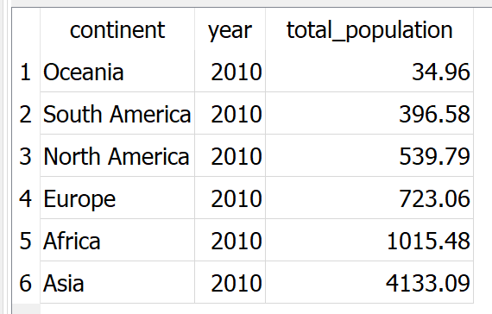
Findings – Part 5
7. What was the total population for each continent in 2010?
*Please note, the total population is also in millions.

Slide 9
Conclusion
As we can see from our findings, the world population from different continents and countries in between the year 2000 and 2010 varies quite significantly. By the year 2010, Asia has the largest population in the world, with the record of approximately 4 billions, whereas Oceania only has approximately 34 millions of total populations.

